Slide 1


Predicting Customer buying behavior
Presented by : Krupa Mamidoju

Slide 2
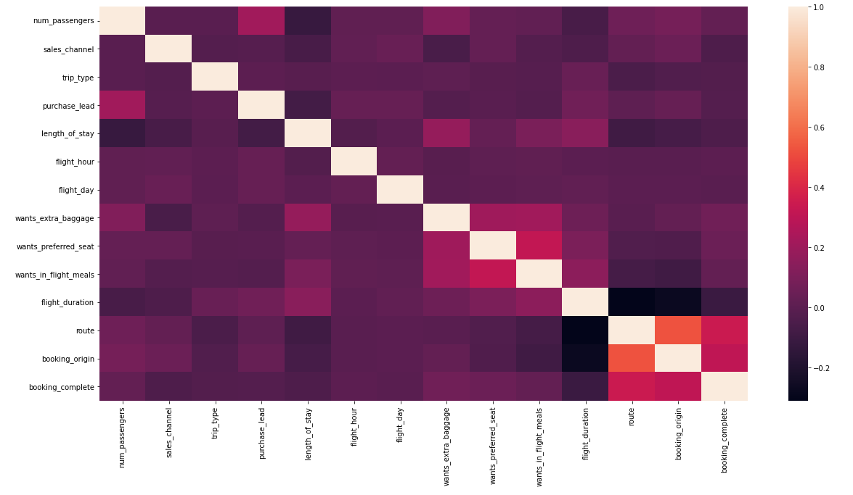
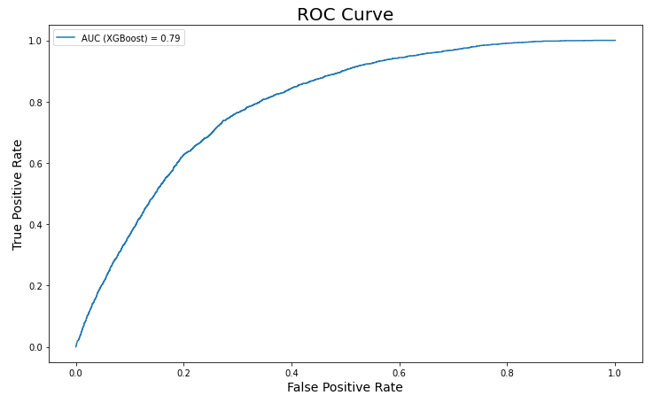
Data Preprocessing
Model Building
We have trained 3 models:
RandomForest Classifier
XgBoost Classifier
CatBoost Classifier
Since we are dealing with unbalanced dataset the Acc metric is not enough to evaluate our models, so we chose the best model performance based on it's F1-Score:
Since we are dealing with unbalanced dataset the Acc metric is not enough to evaluate our models, so we chose the best model performance based on it's F1-Score:
We first handled the categorical data by mapping the small level categorical data, and applying Target encoding technique for the large categorical features, also we used the StandardScaler to scale features.
I chose to keep all the features since the are no significate correlation between each one of them and the target.
Unbalanced Dataset (Label 0: 42522 | Label 1: 7478) =>We apply oversampling and under-sampling techniques (SMOTE-RUS) to balance the train set
Best Model: XGBoost
Acc: 0.79
F1-Score: 0.66
AUC-Score: 0.79

